Slide 1

A Homotopy Surface Cutting Using Paths Crossing in Geodesic Distance
Anuwat Dechvijankit
Hiroshi Nagahashi
Kota Aoki
Dept. Computational Intelligence and Systems Science
Imaging Science and Engineering Laboratory
Tokyo Institute of Technology, Japan

Slide 2
Outline
We present an enhancement method to generate a cut graph in high-genus surface for converting surface into topological disk.
Research Terms and Studies
Geometry Image
MMP Geodesic Distance
Our method.
Results and Conclusion

Slide 3
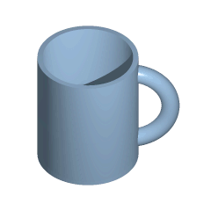
Topology & Genus
Topology is the mathematical study of the properties that are preserved through deformations, twistings, and stretchings of objects.
Genus is a topologically invariant property of a surface defined as the largest number of nonintersecting simple closed curves that can be drawn on the surface without separating it. Roughly speaking, it is the number of holes in a surface.
From: http://mathworld.wolfram.com/

Slide 4
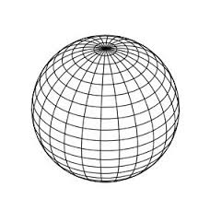
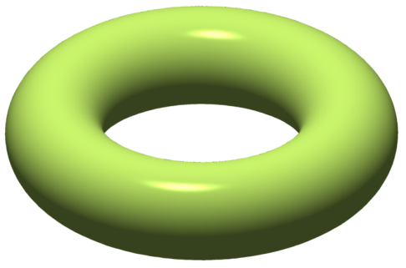
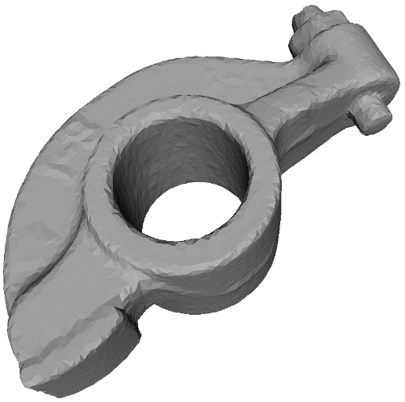
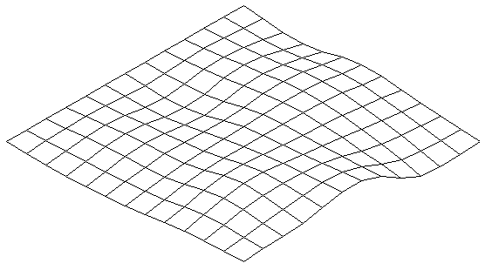
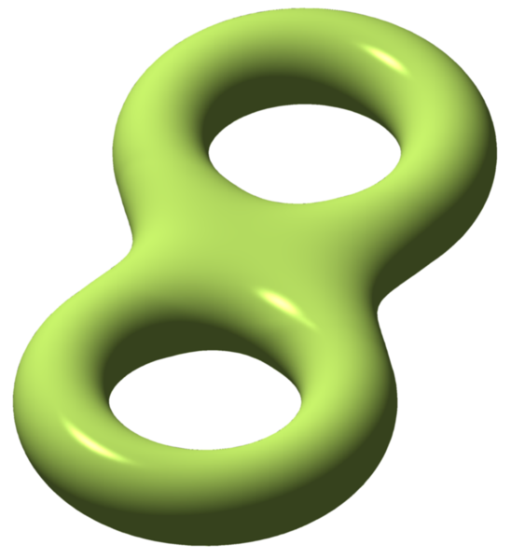
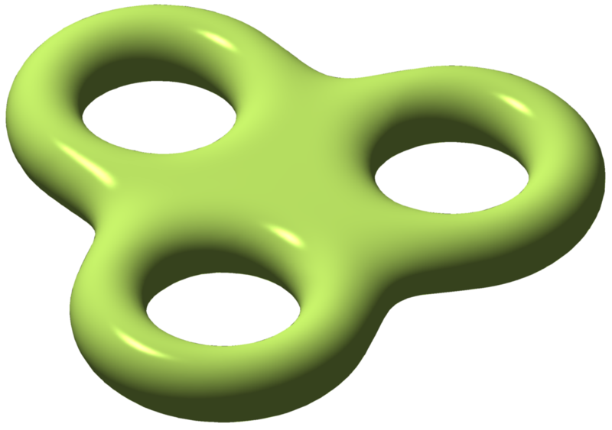
Genus example
genus 0
genus 1
genus 2
genus 3
http://en.wikipedia.org/wiki/Genus_(mathematics)

Slide 5
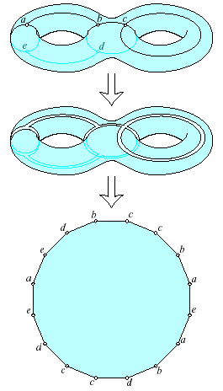
Previous Study
Optimally cutting a surface into a disk Jeff Erickson and Sariel Har-Peled, (SCG '02).
Finds the shortest loop connecting a mesh vertex to itself using front propagation.
The loops are then tested to see if they reduce the surface genus or simply cut the surface into two pieces.
A lot of time consuming !!! (brute force)
Computing minimum cut graphs is NP-Hard problem.
2g loops as topologically sufficient cut.

Slide 6
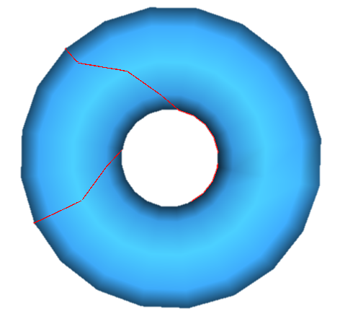
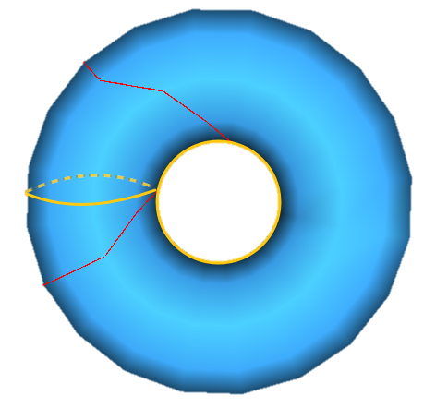
My previous work ’ problems

Slide 7
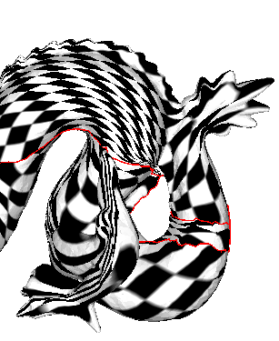
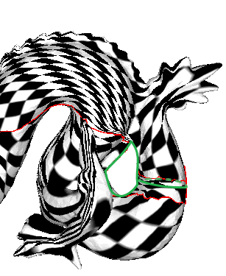
My previous work ’ problems

Slide 8
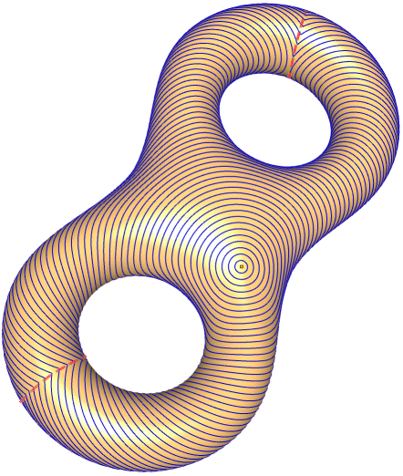

Geodesic distance
Image from “Fast Exact and Approximate Geodesics on Meshes”

Slide 9
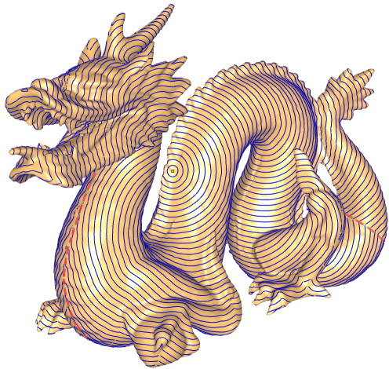

Geodesic distance

Slide 10
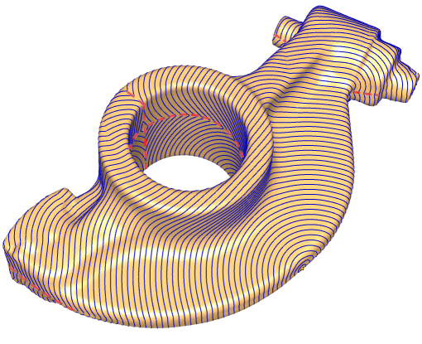

Geodesic distance

Slide 11
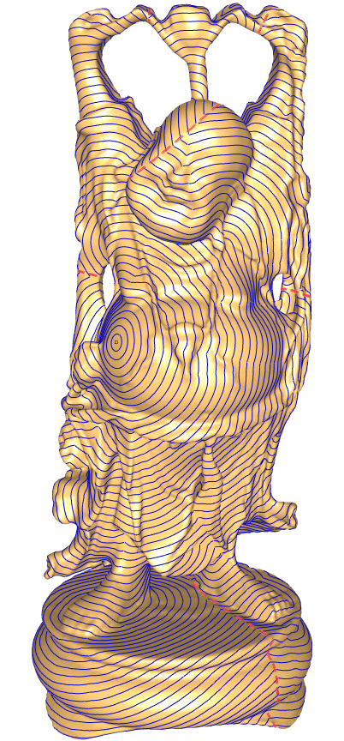

Geodesic distance

Slide 12
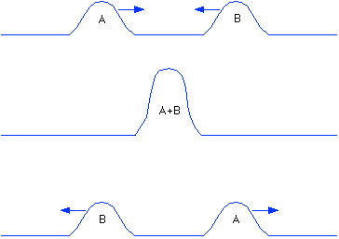
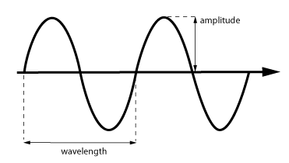
Proposed method’s Idea
We create a (half wavelength) wave from a position in genus g mesh
Let the wave travel with the constant speed over the surface.
The closest edges that wave interference occurred might be genus reduce cutting.

Slide 13
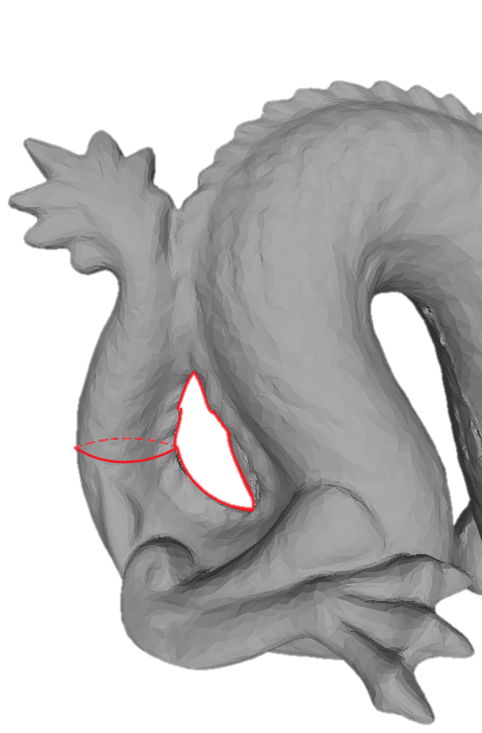
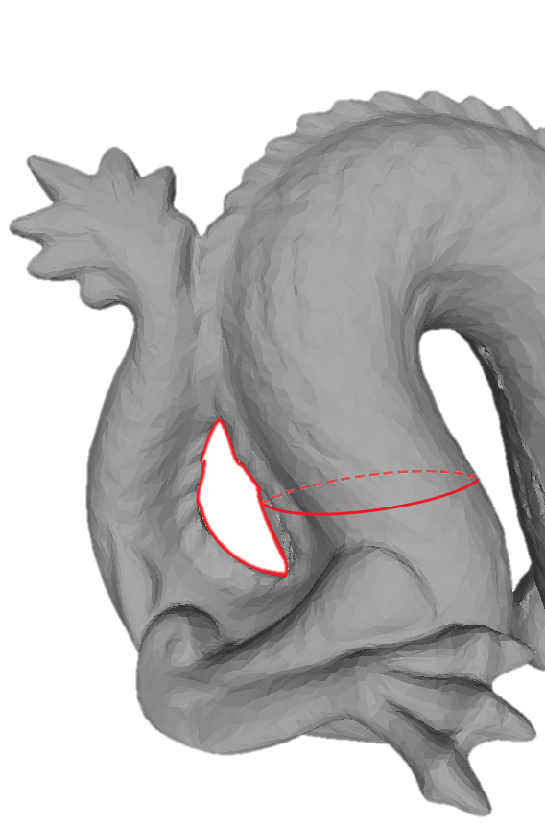
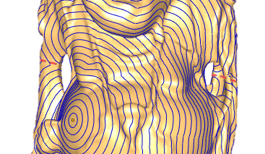
Challenge
Simulate wave travelling into logic.
Time consuming…
Where should be the starting position of the wave?
How to judge “wave interference”？

